Slide 1
Chapter 3: Processes

Slide 2
Chapter 3: Processes
Process Concept
Process Scheduling
Operations on Processes

Slide 3
Process Concept
Process – a program in execution; process execution must progress in sequential fashion
Program is passive entity stored on disk (executable file), process is active
  Program becomes process when executable file loaded into memory
Multiple parts
  The program code, also called text section
  Current activity including program counter, processor registers
  Stack containing temporary data
    Function parameters, return addresses, local variables
  Data section containing global variables
  Heap containing memory dynamically allocated during run time

Slide 4

Process in Memory

Slide 5
Process State
As a process executes, it changes state
  new: The process is about to be created but not yet created, it is the program which is present in secondary memory that will be picked up by OS to create the process.
  running: Instructions are being executed
  waiting: The process is waiting for some event to occur
  ready: The process is waiting to be assigned to a processor
  terminated: The process has finished execution

Slide 6

Diagram of Process State

Slide 7
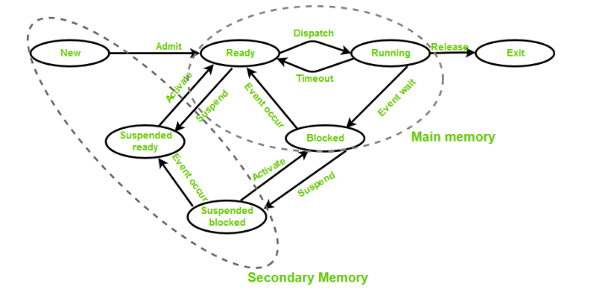
Suspend ready – Process that was initially in the ready state but was swapped out of main memory and placed onto external storage by scheduler is said to be in suspend ready state. The process will transition back to ready state whenever the process is again brought onto the main memory.
Suspend wait or suspend blocked – Similar to suspend ready but uses the process which was performing I/O operation and lack of main memory caused them to move to secondary memory. When work is finished it may go to suspend ready.

Slide 8

Process Control Block (PCB)
Information associated with each process
(also called task control block)
Process state – running, waiting, etc
Program counter – location of instruction to next execute
CPU registers – contents of all process-centric registers
CPU scheduling information- priorities, scheduling queue pointers
Memory-management information – memory allocated to the process
Accounting information – CPU used, clock time elapsed since start, time limits
I/O status information – I/O devices allocated to process, list of open files

Slide 9

CPU Switch From Process to Process

Slide 10
Process Scheduling
Maximize CPU use, quickly switch processes onto CPU for time sharing
Process scheduler selects among available processes for next execution on CPU
Maintains scheduling queues of processes
  Job queue – set of all processes in the system
  Ready queue – set of all processes residing in main memory, ready and waiting to execute
  Device queues – set of processes waiting for an I/O device
  Processes migrate among the various queues

Slide 11

Ready Queue And Various I/O Device Queues

Slide 12

Representation of Process Scheduling
Queueing diagram represents queues, resources, flows

Slide 13
Schedulers
Short-term scheduler (or CPU scheduler) – selects which process should be executed next and allocates CPU
  Sometimes the only scheduler in a system
  Short-term scheduler is invoked frequently (milliseconds) ⇒ (must be fast)
Long-term scheduler (or job scheduler) – selects which processes should be brought into the ready queue
  Long-term scheduler is invoked infrequently (seconds, minutes) ⇒ (may be slow)
  The long-term scheduler controls the degree of multiprogramming
Processes can be described as either:
  I/O-bound process – spends more time doing I/O than computations, many short CPU bursts
  CPU-bound process – spends more time doing computations; few very long CPU bursts
Long-term scheduler strives for good process mix

Slide 14

Addition of Medium Term Scheduling
Medium-term scheduler can be added if degree of multiple programming needs to decrease
  Remove process from memory, store on disk, bring back in from disk to continue execution: swapping

Slide 15
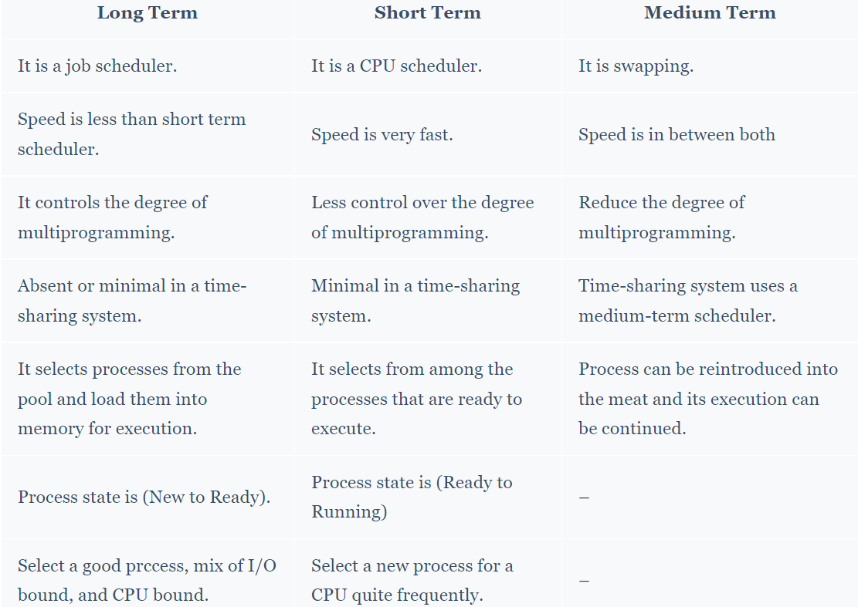

Slide 16
Context Switch
When CPU switches to another process, the system must save the state of the old process and load the saved state for the new process via a context switch
Context of a process represented in the PCB
Context-switch time is overhead; the system does no useful work while switching

Slide 17
Operations on Processes
System must provide mechanisms for:
  process creation,
  process termination,
  and so on as detailed next

Slide 18
Process Creation
Parent process create children processes, which, in turn create other processes, forming a tree of processes
Generally, process identified and managed via a process identifier (pid)
Resource sharing options
  Parent and children share all resources
  Children share subset of parent’s resources
  Parent and child share no resources
Execution options
  Parent and children execute concurrently
  Parent waits until children terminate

Slide 19

A Tree of Processes in Linux

Slide 20

Process Creation (Cont.)
Address space
  Child duplicate of parent
  Child has a program loaded into it
UNIX examples
  fork() system call creates new process
  exec() system call used after a fork() to replace the process’ memory space with a new program

Slide 21

C Program Forking Separate Process

Slide 22
Process Termination
Process executes last statement and then asks the operating system to delete it using the exit() system call.
  Returns status data from child to parent (via wait())
  Process’ resources are deallocated by operating system
Parent may terminate the execution of children processes using the abort() system call. Some reasons for doing so:
  Child has exceeded allocated resources
  Task assigned to child is no longer required
  The parent is exiting and the operating systems does not allow a child to continue if its parent terminates

Slide 23
Process Termination
Some operating systems do not allow child to exists if its parent has terminated. If a process terminates, then all its children must also be terminated.
  cascading termination. All children, grandchildren, etc. are terminated.
  The termination is initiated by the operating system.
The parent process may wait for termination of a child process by using the wait()system call. The call returns status information and the pid of the terminated process
pid = wait(&status);
If no parent waiting (did not invoke wait()) process is a zombie
If parent terminated without invoking wait , process is an orphan

Slide 24
End of Chapter 3

